Slide 1
CompTIA A+ Guide to IT Technical Support
10th Edition

Slide 2
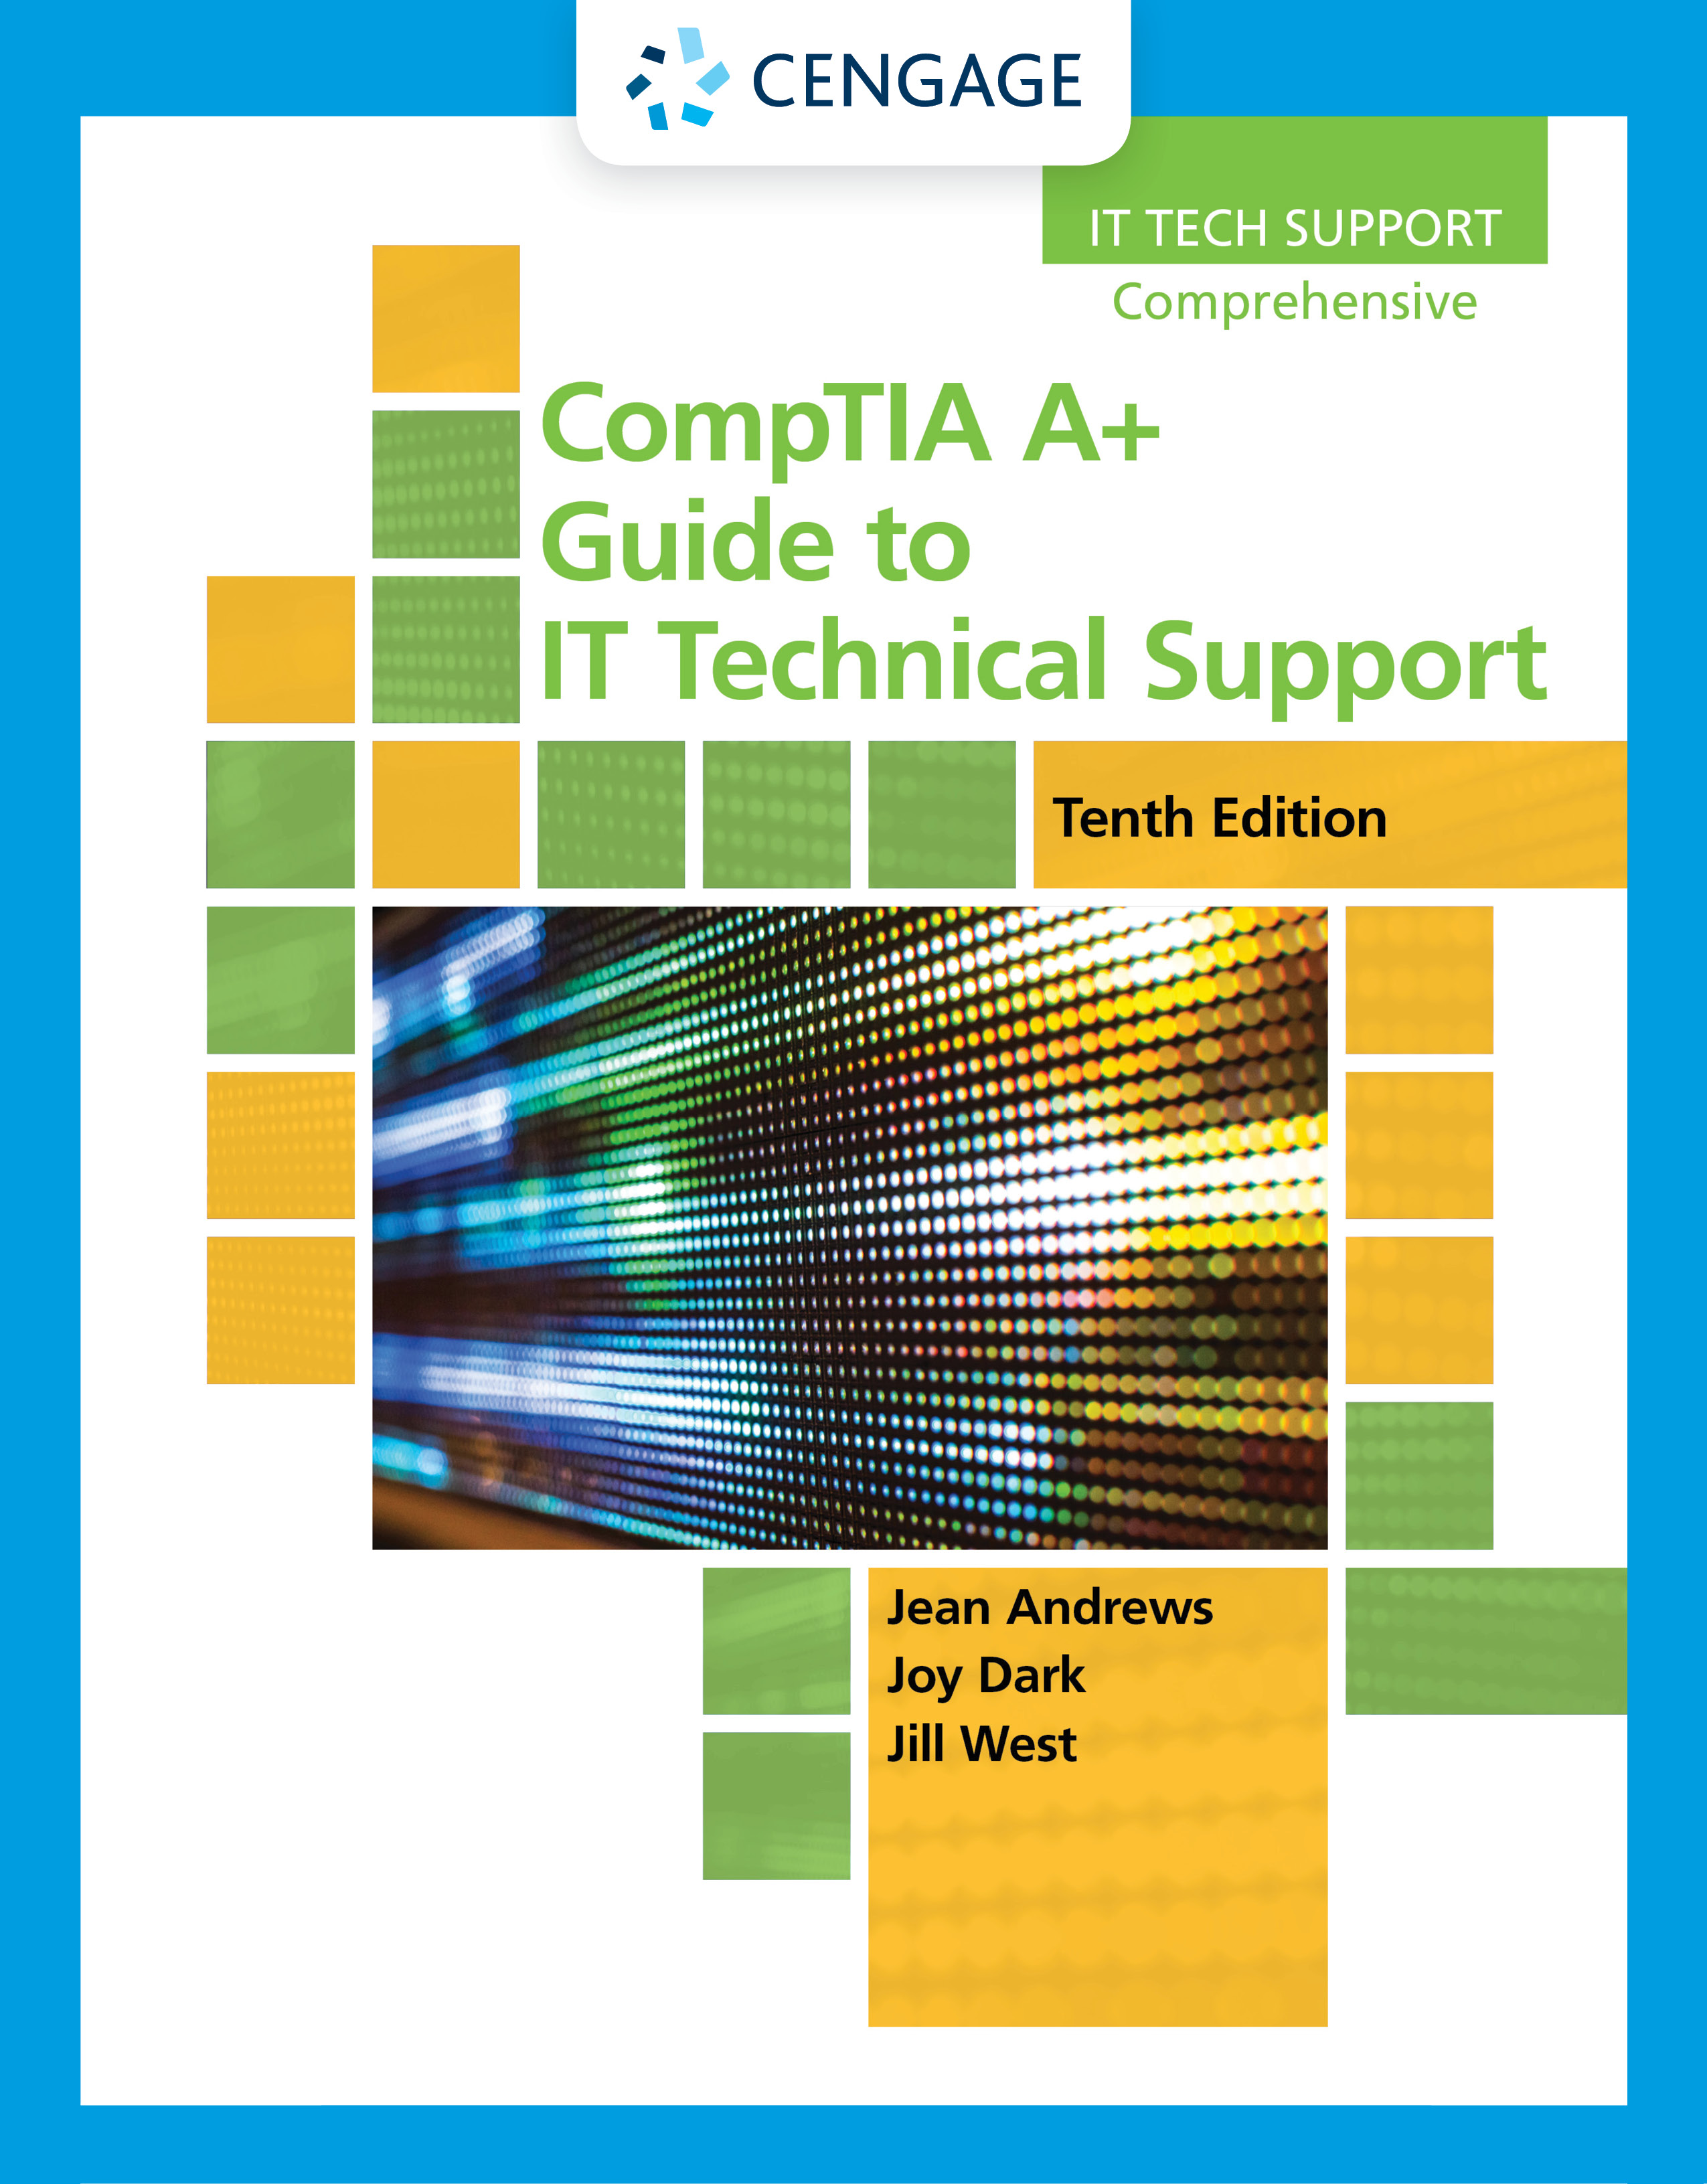
All About Motherboards
Chapter 2

Slide 3
Objectives
Describe and contrast various types and features of motherboards
Configure a motherboard using BIOS/UEFI firmware
Maintain a motherboard by updating drivers and firmware, using jumpers to clear BIOS/UEFI settings, and replacing the CMOS battery
Select, install, and replace a desktop motherboard or laptop system board

Slide 4
Motherboard Types and Features (1 of 2)
Motherboard
Most complicated computer component
One of the first items to consider when building a computer
Consider the following when purchasing a motherboard:
Form factor
Processor socket and chipset
Expansion slots
Other connectors, slots, and ports

Slide 5
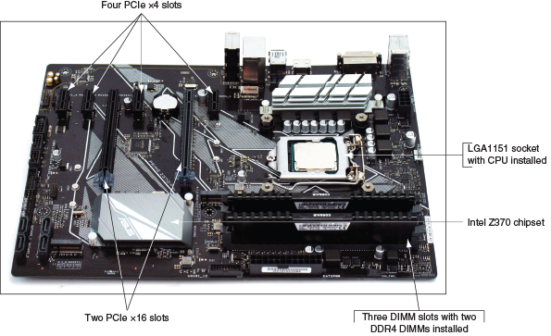
Motherboard Types and Features (2 of 2)
Figure 2-1 The Asus Prime Z370-P gaming motherboard uses the ATX form factor and LGA1151 8th generation process socket

Slide 6
Motherboard Form Factors (1 of 5)
Motherboard form factor determines motherboard size and features that make it compatible with power supplies and cases
Most popular:
ATX, microATX, and Mini-ITX
Mini-ITX is smaller than microATX and is also known as mITX
The following slides show examples of form factors and comparisons of sizes and hole positions of several form factors

Slide 7
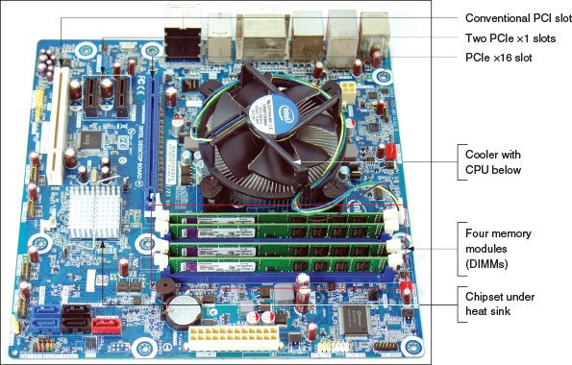
Motherboard Form Factors (2 of 5)
Figure 2-2 The Intel desktop motherboard DH676D uses the mATX form factor and has the processor, cooler, and memory modules installed

Slide 8
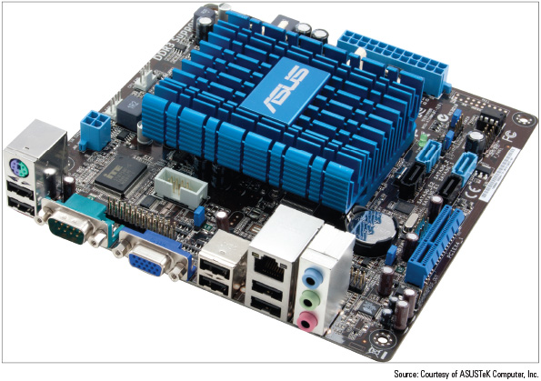
Motherboard Form Factors (3 of 5)
Figure 2-3 A Mini-ITX motherboard

Slide 9
Motherboard Form Factors (4 of 5)
Form Factor | Motherboard Size | Description
ATX, full size | Up to 12” x 9.6” (305mm x 244mm) | A popular form factor that has had many revisions and variations
microATX (mATX) | Up to 9.6” x 9.6” (244mm x 244mm) | A smaller version of ATX
Mini-ITX (mITX and ITX) | Up to 6.7” x 6.7” (170mm x 170mm) | A small form factor (SFF) board used in low-end computers and home theater systems

Slide 10
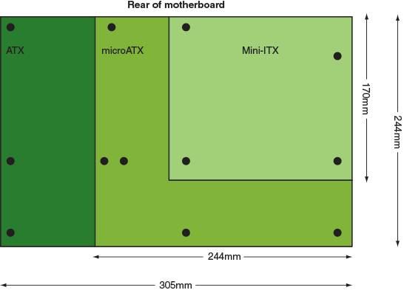
Motherboard Form Factors (5 of 5)
Figure 2-4 Sizes and hole positions for the ATX, microATX, and Mini-ITX motherboards

Slide 11
Intel and AMD Chipsets and Processor Sockets (1 of 8)
A chipset is a set of chips on the motherboard that works closely with the processor to control the memory, buses on the motherboard, and some peripherals
Must be compatible with the processor it serves
A socket is rectangular with pins or pads to connect the processor to the motherboard
Two major chipset and processor manufacturers:
Intel
AMD

Slide 12
Intel and AMD Chipsets and Processor Sockets (2 of 8)
Intel Chipsets:
Coffee Lake
Kaby Lake
Skylake
Broadwell and Haswell
Since the release of the 2nd generation of Intel Core family of processors:
You can know which generation a processor fits in by the four digits in the model number
Example: Core i5-13200U processor is a 13th generation processor

Slide 13
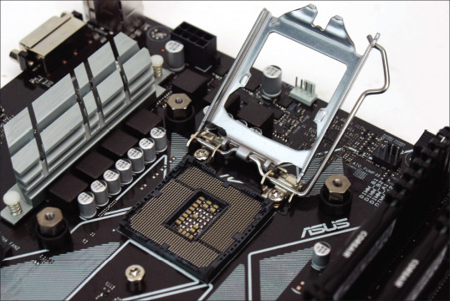
Intel and AMD Chipsets and Processor Sockets (3 of 8)
Figure 2-5 The 8th generation LGA1151 socket with the cover removed and load plate lifted, ready to receive the processor

Slide 14
Intel and AMD Chipsets and Processor Sockets (4 of 8)
Sockets for Intel Processors LGA = Land grid array
Current Intel sockets for desktop computers:
LGA1151
LGA1150
LGA1155
Intel sockets used in servers and high-performance workstations:
LGA2066
LGA2011
LGA1366

Slide 15
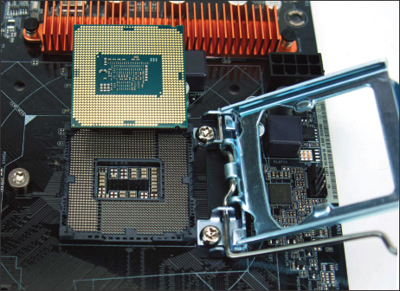
Intel and AMD Chipsets and Processor Sockets (5 of 8)
Figure 2-6 The 7th and 6th generation LGA1151 open socket and the bottom of an Intel processor

Slide 16
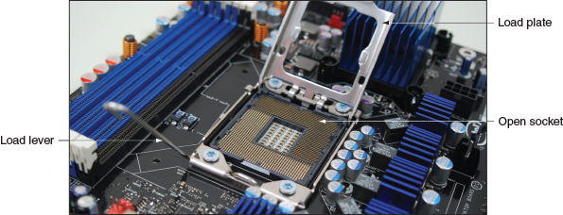
Intel and AMD Chipsets and Processor Sockets (6 of 8)
Figure 2-8 The LGA1366 socket with the socket cover removed and the load plate lifted ready to receive a processor

Slide 17
Intel and AMD Chipsets and Processor Sockets (7 of 8)
Zero insertion force (ZIF) sockets are used to lift the processor up and out of the socket, using levers
AMD Chipsets and Sockets
Current AMD chipset and socket categories for personal computers:
TR4 (Threadripper 4) socket uses the AMD X399 chipset
AM4 chipset family and AM4 socket is used with AMD Ryzen and Athlon processors
AM3+ and AM3 are PGA sockets used with AMD Piledriver and Bulldozer processors
FM2+ is an older PGA socket used with AMD Athlon, Steamroller, and Excavator processors and A-series chipsets

Slide 18
Intel and AMD Chipsets and Processor Sockets (8 of 8)
Match a Processor to the Socket and Motherboard
You must pay close attention to the actual model number of the processor to know which socket it requires and which motherboards can support it
To match a processor to a motherboard and socket:
Look at the motherboard manufacturer’s website or user guide for a list of processors the motherboard supports
You can also search the Intel or AMD website for the exact processor to make sure the socket it uses is the same as the socket on the motherboard

Slide 19
Buses and Expansion Slots (1 of 8)
Fine lines found on both the top and the bottom of a motherboard are sometimes called traces
Traces are circuits or paths that enable data, instructions, timing signals, and power to move from component to component on the board
Bus:
System of pathways used for communication and the protocol and methods used for transmission
A protocol is a set of rules and standards that any two entities use for communication

Slide 20
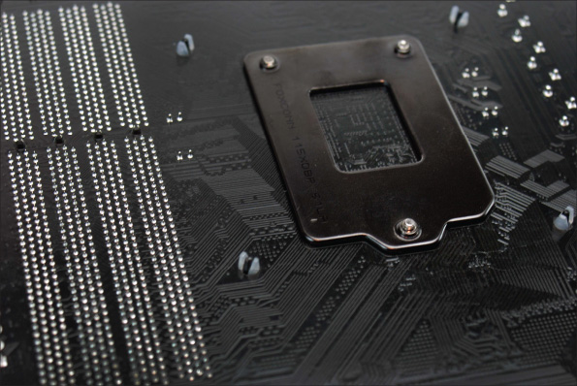
Buses and Expansion Slots (2 of 8)
Figure 2-10 On the bottom of the motherboard, you can see the bus lines terminating at the processor socket

Slide 21
Buses and Expansion Slots (3 of 8)
PCI Express
PCIe currently comes in four different slot sizes called PCI Express x1, x4, x8, and x16
The number after the “x” refers to the number of lanes available for data
Example: PCIe x4 contains 4 lanes
PCIe x16 slot is used by graphics cards that require large throughput
To provide extra wattage required for cards that require large throughput:
The card may have one, two, or three connectors to connect the card to the extra power

Slide 22
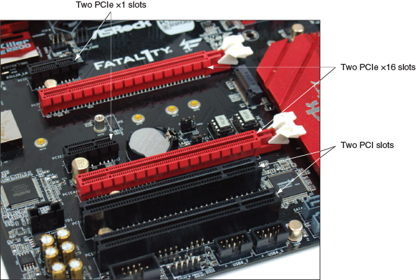
Buses and Expansion Slots (4 of 8)
Figure 2-11 Three types of expansion slots: PCIe x1, PCIe x16, and conventional PCI

Slide 23
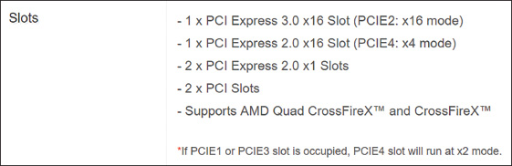
Buses and Expansion Slots (5 of 8)
Figure 2-12 PCIe documentation for one motherboard

Slide 24
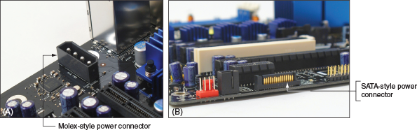
Buses and Expansion Slots (6 of 8)
Figure 2-14 Auxiliary power connectors to support PCIe

Slide 25
Buses and Expansion Slots (7 of 8)
PCI
Conventional PCI slots and buses are slower than those of PCIe
Slots are slightly taller than PCIe slots
Transmits 32 data bits in parallel and operates at about 500 Mbps
Used for all types of add-on cards
Riser Cards Used to Extend the Slots
A low-profile or slimline case may not give you enough room to install an expansion card standing up in a slot
A riser card installs in the slot and provides another slot at a right angle
Riser cards come for all types of PCI and PCIe slots

Slide 26
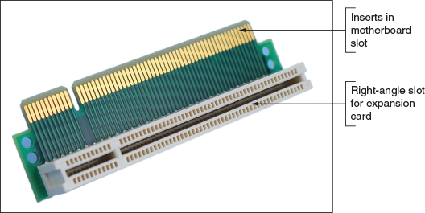
Buses and Expansion Slots (8 of 8)
Figure 2-15 The PCI riser card provides a slot for an expansion card installed parallel to the motherboard

Slide 27
Onboard Ports and Connectors (1 of 9)
Onboard ports (integrated components)
Ports coming directly off the motherboard
May include USB, PS/2 mouse and keyboard, video, sound, network, and eSATA ports
I/O shield
Plate installed in computer case providing holes for I/O ports
Internal connectors
USB, M.2, SATA, and IDE connectors

Slide 28
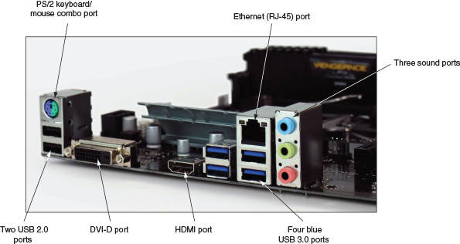
Onboard Ports and Connectors (2 of 9)
Figure 2-16 A motherboard provides ports for common I/O devices

Slide 29
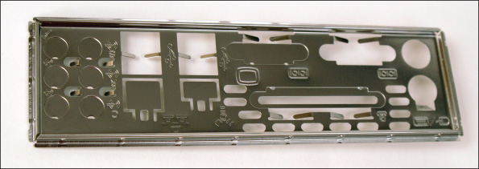
Onboard Ports and Connectors (3 of 9)
Figure 2-17 The I/O shield fits the motherboard ports to the computer case

Slide 30
Onboard Ports and Connectors (4 of 9)
SATA (Serial Advanced Technology Attachment or Serial ATA)
An interface standard used mostly by storage devices
Current versions of SATA:
SATA Express (SATAe)
SATA3
SATA2
M.2
Formerly known as the Next Generation Form Factor (NGFF)
Uses the PCIe, USB, or SATA interface to connect a mini add-on card
Commonly used by wireless cards and solid-state drives (SSDs)

Slide 31
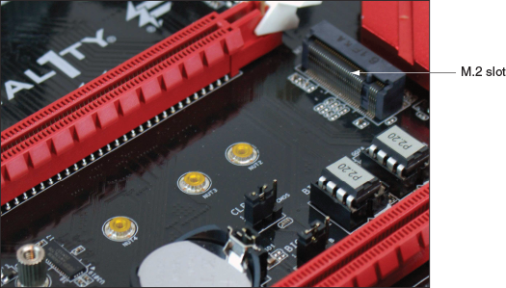
Onboard Ports and Connectors (5 of 9)
Figure 2-20 An M.2 slot and three possible screw positions to secure a card to the motherboard

Slide 32
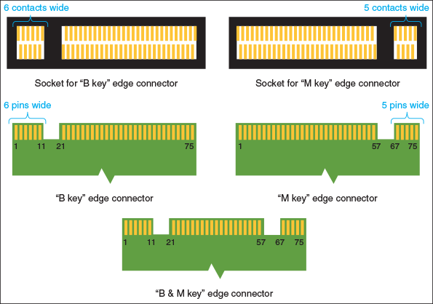
Onboard Ports and Connectors (6 of 9)
Figure 2-21 An M.2 slot is keyed with a notch to hold an M.2 card with a B key or M key edge connector

Slide 33
Onboard Ports and Connectors (7 of 9)
IDE (Integrated Drive Electronics) standard
Used to interface storage devices with the motherboard
IDE connector has 40 pins
USB
USB header is used to connect a cable from a motherboard to USB ports on the front of the computer case

Slide 34
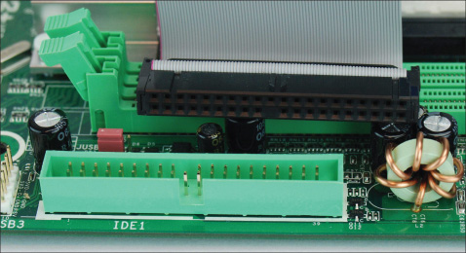
Onboard Ports and Connectors (8 of 9)
Figure 2-22 An IDE connector and cable

Slide 35
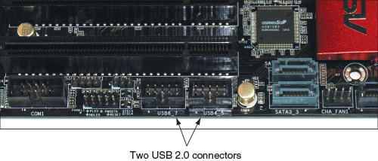
Onboard Ports and Connectors (9 of 9)
Figure 2-23 Two USB headers are used to connect the motherboard to USB ports on the front of the computer case

Slide 36
Using BIOS/UEFI Setup to Configure a Motherboard (1 of 2)
Firmware on the motherboard is used to:
Enable or disable a connector, port, or component
Control the frequency and other features of the CPU
Manage security features
Control what happens when the computer first boots
Monitor and log various activities of the board
Motherboards made after 2012 use BIOS/UEFI firmware
Prior to 2012, motherboards used BIOS firmware
UEFI (Unified Extensible Firmware Interface) improves on BIOS but includes BIOS for backward compatibility with older devices

Slide 37
Using BIOS/UEFI Setup to Configure a Motherboard (2 of 2)
Facts about UEFI:
Microsoft requires UEFI in order for a system to be certified for Windows 10/8
UEFI is required for hard drives larger than 2 TB
UEFI offers Secure boot, which prevents a system from booting up with drivers or an OD that is not digitally signed and trusted by the motherboard or computer manufacturer
For backward compatibility, UEFI can boot from an MBR hard drive and provide a BIOS boot through its Compatibility Support Module (CSM) feature

Slide 38
Accessing the BIOS/UEFI Setup Program
Access the BIOS/UEFI setup program by pressing a key or combination of keys during the boot process
For most motherboards, you press F12, F2, or Del during the boot
See documentation for your motherboard or watch the screen near the beginning of the boot
Setup screen appears with menus and Help features

Slide 39
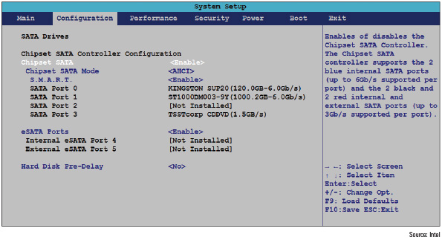
Viewing and Monitoring Information (1 of 2)
Figure 2-26 A BIOS/UEFI setup screen showing a list of drives installed on the system

Slide 40
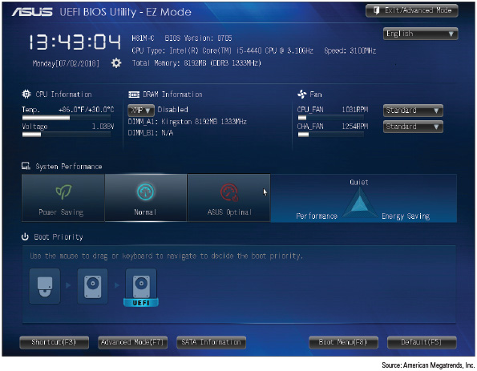
Viewing and Monitoring Information (2 of 2)
Figure 2-27 Information about the system is reported when you first access BIOS/UEFI setup

Slide 41
Changing Boot Options (1 of 5)
In the BIOS/UEFI setup boot menu, you can set the order in which the system tries to boot from certain devices
Called the boot priority order or boot sequence
Boot Priority Order:
Examples where you might need to change the boot priority order:
Some distributions of Linux can be installed on a USB flash drive, so you can boot the OS from this drive when you put the USB device first in the boot priority order
When installing an OS on a hard drive, you might want BIOS/UEFI to first boot from a DVD to install from a setup DVD
If you are installing an OS from a server, put the PCI LAN: EFI Network option at the top of the boot priority and enable PXE Boot to LAN
Boot from the Windows setup DVD to troubleshoot a computer that will not start

Slide 42
Changing Boot Options (2 of 5)
Manage Secure Boot:
Secure boot was invented to help prevent malware from launching before the OS and anti-malware software are launched
Secure boot works only when the boot mode is UEFI (and not CSM) and the OS supports it
Supported by Windows 10/8 and several distributions on Linux
Secure boot holds digital signatures, encryption keys, and drivers in databases stored in flash memory on the motherboard and/or the hard drive
When enabled, it checks each driver, the OS, and applications before UEFI launches these programs to verify it is signed and identified in the Secure boot databases

Slide 43
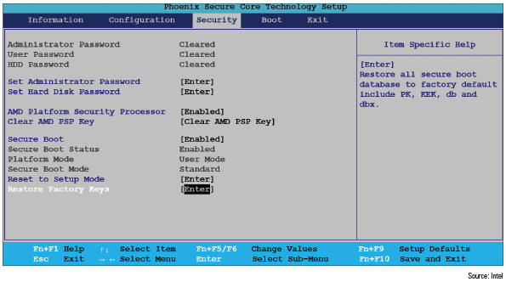
Changing Boot Options (3 of 5)
Figure 2-30 Manage Secure boot on the Security screen of BIOS/UEFI setup

Slide 44
Changing Boot Options (4 of 5)
Manage CSM and UEFI Boot:
The Boot screen allows you to select UEFI mode of CSM (Compatibility Support Module) mode
UEFI mode is required for Secure boot to be enabled
Use CSM for backward compatibility with older BIOS devices and drivers and MBR hard drives

Slide 45
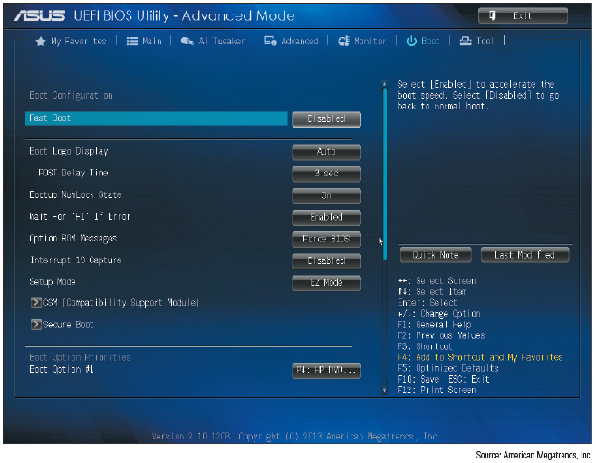
Changing Boot Options (5 of 5)
Figure 2-31 Use CSM to boot a legacy BIOS system or disable it to implement UEFI Secure boot

Slide 46
Configuring Onboard Devices (1 of 2)
You can enable or disable some onboard devices using BIOS/UEFI setup
For example: network ports, USB ports, or video ports
What you can configure on your system depends on the onboard devices the motherboard offers
Overclocking:
Running a processor, memory, motherboard, or video card at a higher speed than the manufacturer recommends
Some motherboards and processors allow overclocking, but it is not a recommended best practice

Slide 47
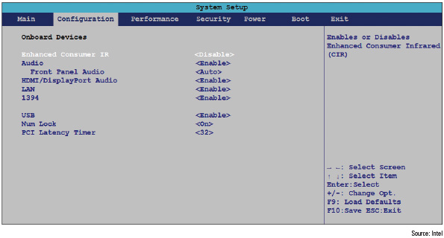
Configuring Onboard Devices (2 of 2)
Figure 2-32 Enable and disable onboard devices

Slide 48
Configuring Security Features (1 of 5)
Other security features besides Secure boot:
Power-on passwords
LoJack
Drive password protection
TPM chip
Drive encryption

Slide 49
Configuring Security Features (2 of 5)
Power-On Passwords:
Power-on passwords are assigned in BIOS/UEFI setup to prevent unauthorized access to the computer and/or BIOS/UEFI setup utility
Depending on the motherboard, it may be possible to set a supervisor and user password
How to set passwords varies depending on motherboard and BIOS

Slide 50
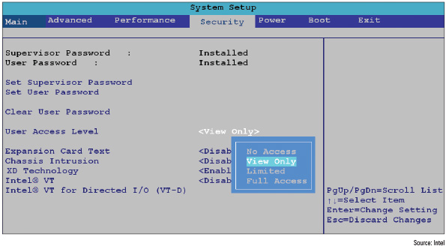
Configuring Security Features (3 of 5)
Figure 2-33 Set supervisor and user passwords in BIOS/UEFI setup to help lock down a computer

Slide 51
Configuring Security Features (4 of 5)
LoJack for Laptops Technology:
LoJack and Computrace Agent technology are embedded in the firmware of many laptops to protect a system against theft
Must subscribe to the service
The service can be used to locate a laptop whenever it connects to the Internet
Once located, you can give commands through the Internet to lock the laptop or delete all data on it
Drive Password Protection:
Some motherboards allow you to set a password in order to access the hard drive
Does not encrypt all the data on the drive but encrypts only a few organizational sectors

Slide 52
Configuring Security Features (5 of 5)
The TPM Chip and Hard Drive Encryption:
Many motherboards contain a chip called the TPM (Trusted Platform Module) chip
The BitLocker Encryption tool in Windows 10/8/7 works with this chip
An encryption key (startup key) is kept on the chip
Assures that a drive cannot be used in another computer
Can be used with other encryption software that may be installed on the hard drive other than BitLocker
If the motherboard fails and is replaced, you’ll need a backup copy of the startup key to access data on the hard drive

Slide 53
BIOS Support for Virtualization
Virtualization is when one physical computer uses software to create multiple virtual computers
A virtual machine (VM) simulates the hardware of a physical computer
Each VM works like a physical computer and is assigned virtual devices such as virtual motherboard and virtual hard drive
Virtualization must be enabled in BIOS/UEFI setup

Slide 54
Exiting the BIOS/UEFI Setup Menus (1 of 2)
When you finish with BIOS/UEFI setup, an exit screen gives you various options, such as:
Saving your changes and exiting
Discarding your changes and exiting
Some offer the option to Load Optimized Defaults
This option can sometimes solve a problem when a user has made several inappropriate changes to the BIOS/UEFI settings or you are attempting to recover from an error created while updating the firmware

Slide 55
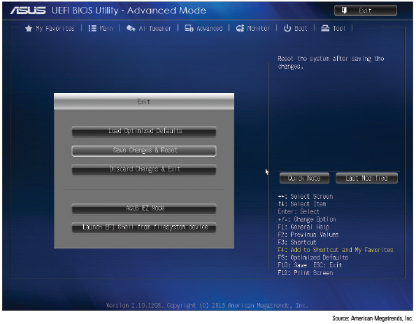
Exiting the BIOS/UEFI Setup Menus (2 of 2)
Figure 2-34 The BIOS/UEFI Utility Exit Screen

Slide 56
Updating Motherboard Drivers and BIOS/UEFI
When a motherboard is causing problems or you want to use a new OS or hardware device:
You might need to update the motherboard drivers or update the BIOS/UEFI firmware
Both skills are covered next

Slide 57
Installing or Updating Motherboard Drivers (1 of 2)
Device drivers are small programs that allow software to interact with certain hardware
The CD or DVD that comes with the motherboard contains a user guide and drivers for its onboard components
After installing a motherboard, you can install the drivers from CD or DVD and later update them by downloading updates from the motherboard manufacturer’s website
Sometimes updates are included in updates to Windows
Be sure to get the correct drivers for the OS edition and type (example: Windows 10 64-bit) you are using with the board

Slide 58
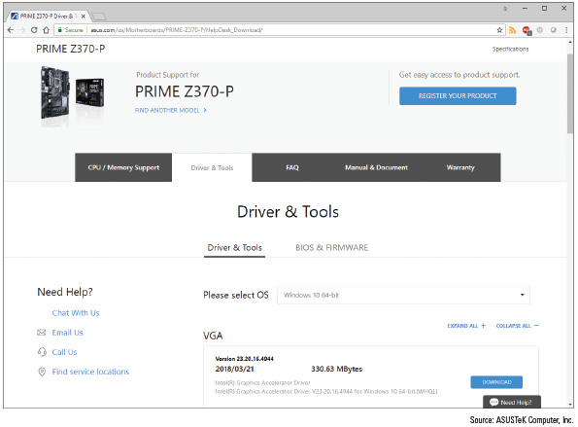
Installing or Updating Motherboard Drivers (2 of 2)
Figure 2-36 Download drivers, utilities, BIOS/UEFI updates, documentation, and other help software from the motherboard manufacturer’s website

Slide 59
Updating Firmware (1 of 2)
The process of upgrading or refreshing the programming and data stored on the firmware chip is called updating firmware, flashing BIOS/UEFI, or flashing BIOS
Reasons to flash the BIOS/UEFI:
The system hangs at odd times or during boot
Some motherboard functions have stopped working or are causing problems
You get errors when trying to install a new OS or hardware device
You want to incorporate some new features or a new component on the board

Slide 60
Updating Firmware (2 of 2)
To flash BIOS/UEFI, always follow the directions found in the user guide for your motherboard
Motherboards can use one or more of these methods:
Download and update from within BIOS/UEFI setup
Update from a USB flash drive using BIOS/UEFI setup
Run an express BIOS/UEFI update
Cautions to be aware of when updating BIOS/UEFI firmware:
Don’t update firmware without a good reason
Back up first
Select the correct update file
Don’t interrupt the update

Slide 61
Using Jumpers to Clear BIOS/UEFI Settings (1 of 3)
A jumper is two small posts or metal pins that stick up off the motherboard that is used to hold configuration information
Open jumper has no cover and a closed jumper has a cover on the two pins
Jumpers can be used to clear a forgotten supervisor or power-on password
If flashing BIOS/UEFI fails, a jumper can be set to undo the update

Slide 62
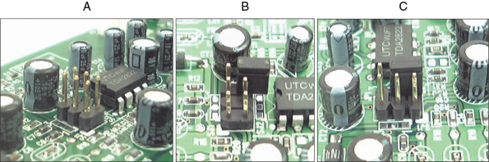
Using Jumpers to Clear BIOS/UEFI Settings (2 of 3)
Figure 2-37 A 6-pin jumper group on a circuit board: (a) has no jumpers set to on, (b) has a cover parked on one pin, and (c) is configured with one jumper setting turned on

Slide 63
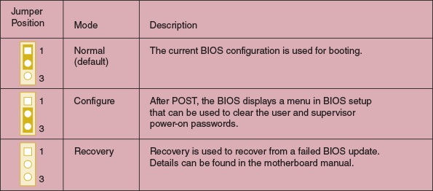
Using Jumpers to Clear BIOS/UEFI Settings (3 of 3)
Figure 2-39 BIOS configuration jumper settings

Slide 64
Replacing the CMOS Battery
CMOS (complementary metal-oxide semiconductor) is a method of manufacturing microchips
CMOS RAM is a small amount of memory stored on the motherboard that retains data even when the computer is turned off
It is charged by a nearby lithium coin-cell battery
To replace the CMOS battery:
Choose correct replacement battery (must be an exact match to the original or the manufacturer’s recommendation)
Power down system, unplug it, press power button to drain the power, remove case cover
Use ESD strap, remove old battery using a flat-head screwdriver, pop new battery into place

Slide 65
Installing or Replacing a Motherboard
A motherboard is considered a field replaceable unit
A technician needs to know how to:
Select an appropriate motherboard
Install or replace one in a desktop or laptop computer

Slide 66
How to Select A Desktop Motherboard (1 of 2)
Three approaches to selecting a motherboard:
Select the board that provides the most room for expansion
So you can upgrade and exchange components and add devices easily
Select the board that best suits the needs of the computer’s current configuration
Select a motherboard that meets your present needs with moderate room for expansion
Ask the following questions when selecting a motherboard:
How is the motherboard to be used?
What form factor does the motherboard use?
Which brand (Intel or AMD) and model processors does the board support? Which chipset does it use? Which processors does it support?
Which type and speed of memory does the board support?

Slide 67
How to Select A Desktop Motherboard (2 of 2)
Ask the following questions when selecting a motherboard (continued):
What are the embedded expansion slots, internal and external connectors, and devices on the board?
Does the board fit the case you plan to use?
What are the price and the warranty on the board? Does the board get good reviews?
How extensive and user friendly is the documentation and how helpful is the manufacturer website?
What warranty and how much support does the manufacturer supply for the board?

Slide 68
How to Install or Replace a Motherboard (1 of 2)
General process for replacing a motherboard:
1. Verify right motherboard is selected
2. Get familiar with documentation, features, settings
3. Remove components to reach old motherboard
4. Install the I/O shield
5. Install the motherboard
6. Install the processor and processor cooler
7. Install RAM
8. Attach cabling (case switches, power supply, drives)
9. Install video card on motherboard
10. Plug the computer into a power source, attach the monitor, keyboard, and mouse

Slide 69
How to Install or Replace a Motherboard (2 of 2)
General process for replacing a motherboard (continued):
11. Boot the system and enter UEFI/BIOS setup
12. Observe POST and verify no errors
13. Verify that Windows starts with no errors
14. Install the motherboard drivers
15. Install other expansion cards and drivers
16. Verify that the system is operating properly, make final OS and BIOS/UEFI adjustments
Example: setting power-on passwords

Slide 70
Replacing a Laptop System Board (1 of 3)
When replacing the motherboard on a laptop, you may need to fully disassemble the entire laptop
Consider alternatives before proceeding
General procedure for replacing the motherboard:
1. Update Windows and device drivers and make sure Windows is working properly
2. Disconnect the AC adapter and press Fn + S + V to set the battery in Ship Mode
3. Remove the hard drive slot compartment cover and the hard drive
Next, remove the slot compartment cover that gives access to the memory and Mini PCIe card, and then remove these two components
4. To remove the keyboard bezel, remove the 13 screws, detach the touch pad and keyboard ribbon cables from the two FPC (flexible printed circuit) connectors

Slide 71
Replacing a Laptop System Board (2 of 3)
General procedure for replacing the motherboard (continued):
5. To detach the system board, remove the 5 screws holding it in place and then remove the 6 ribbon cables connecting the speakers, hard drive, optical drive, USB ports, battery, camera, and LCD panel
6. Follow directions in reverse order to reassemble the system

Slide 72
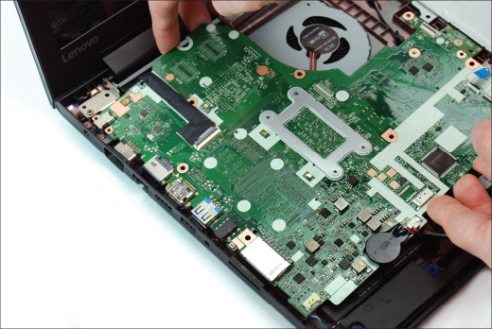
Replacing a Laptop System Board (3 of 3)
Figure 2-45 Detach the system board from jacks on the left side of the case and then lift the system board up and out of the case

Slide 73
Chapter Summary (1 of 3)
The motherboard is the most complicated of all components inside the computer
The most popular form factors are ATX, microATX, and Mini-ITX
The chipset embedded on the motherboard determines what kind of processor and memory the board can support
When matching a motherboard to a processor, use only processors the motherboard manufacturer recommends for the board
Components that are built into the motherboard are called onboard components
Other components can be attached to the system in some other way, such as an expansion card, internal connector, or external port
A 40-pin IDE connector on a motherboard was designed to use older IDE storage devices and is seldom seen on modern motherboards

Slide 74
Chapter Summary (2 of 3)
The firmware that controls current motherboards is a combination of the older BIOS and the newer UEFI
UEFI supports the GPT partitioning system for hard drives, which supports hard drives larger than 1 TB
Booting using UEFI mode is required to use Windows Secure boot
Motherboard settings that can be configured using BIOS/UEFI setup include changing the boot priority order, managing Secure boot options, selecting UEFI mode or CSM mode, enabling or disabling onboard devices, overclocking the CPU, and managing power-on passwords
Secure boot uses databases to verify that hardware drivers are digitally signed by their manufacturers
Update motherboard firmware when a component on the board is causing problems or you want to incorporate a new feature or component on the board

Slide 75
Chapter Summary (3 of 3)
When flashing BIOS/UEFI, don’t update firmware without a good reason, backup firmware before you update it, be certain to select the correct update file, and make sure the update process is not interrupted
Jumpers on the motherboard may be used to clear BIOS/UEFI settings, restoring them to factory defaults
When selecting a motherboard, pay attention to the form factor, chipset, expansion slots and memory slots used, and the processors supported
For laptops, it’s usually more cost effective to replace the laptop than to replace a failed system board

